Slide 1


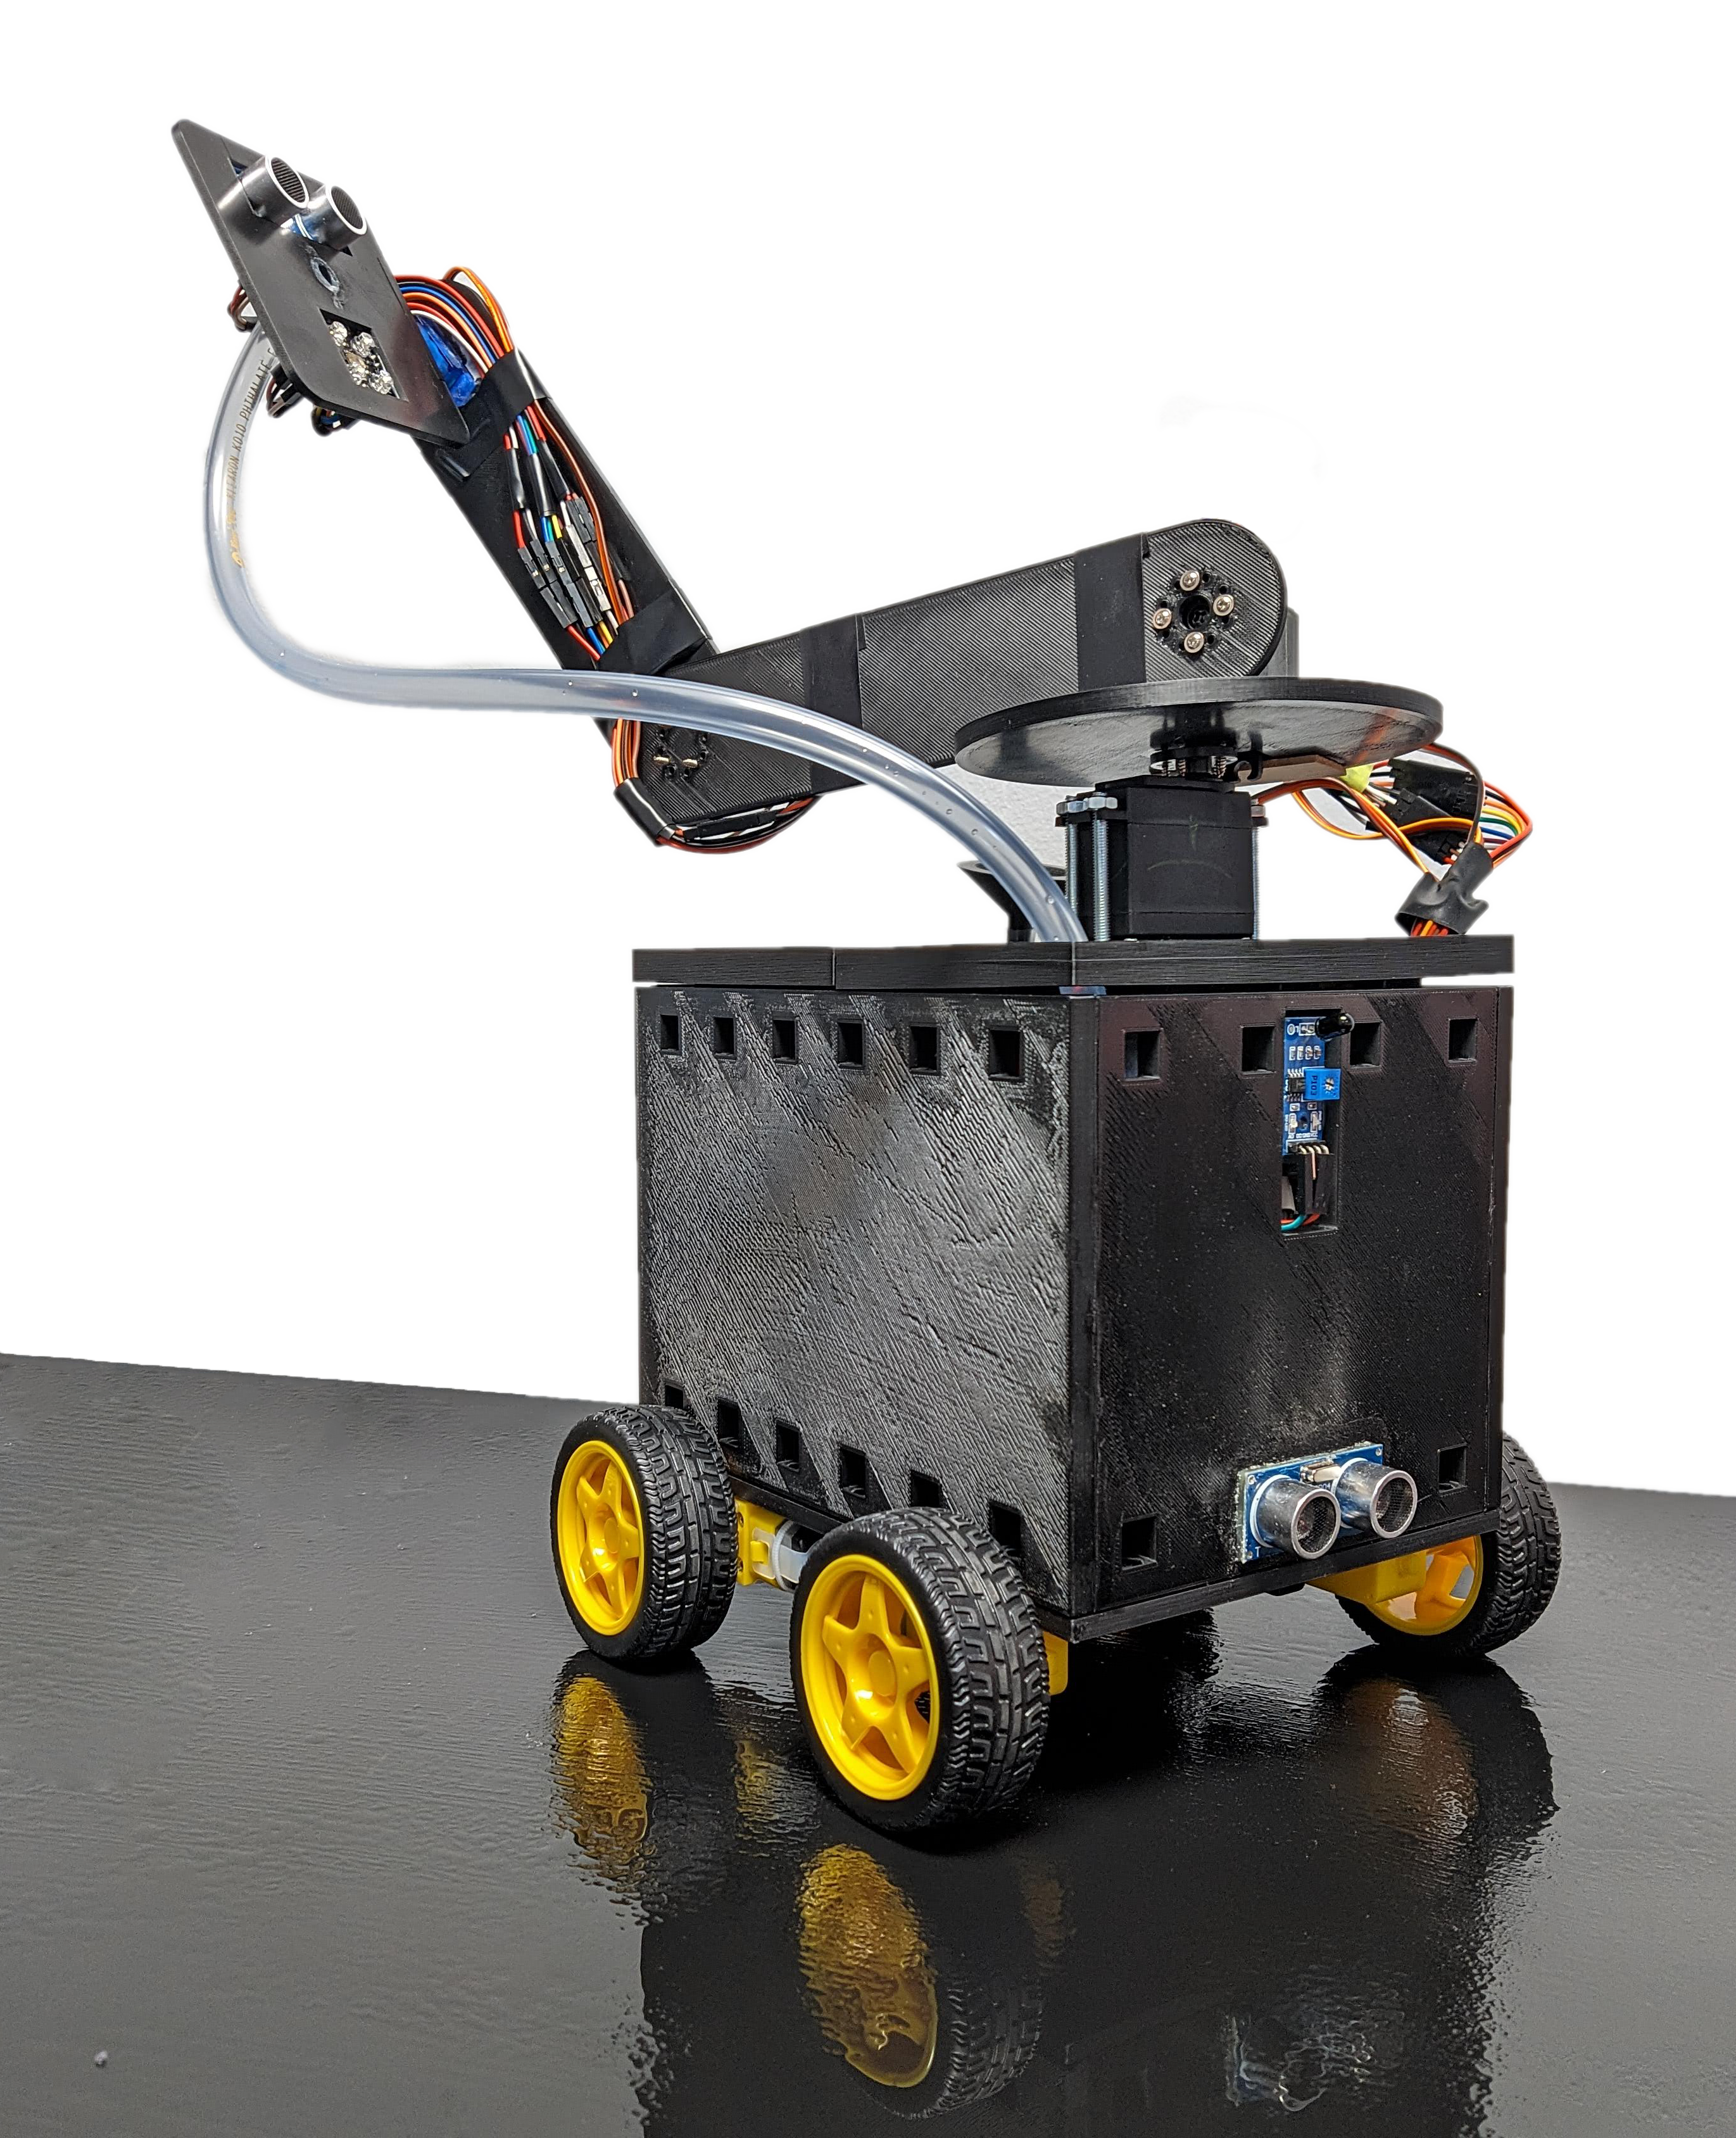
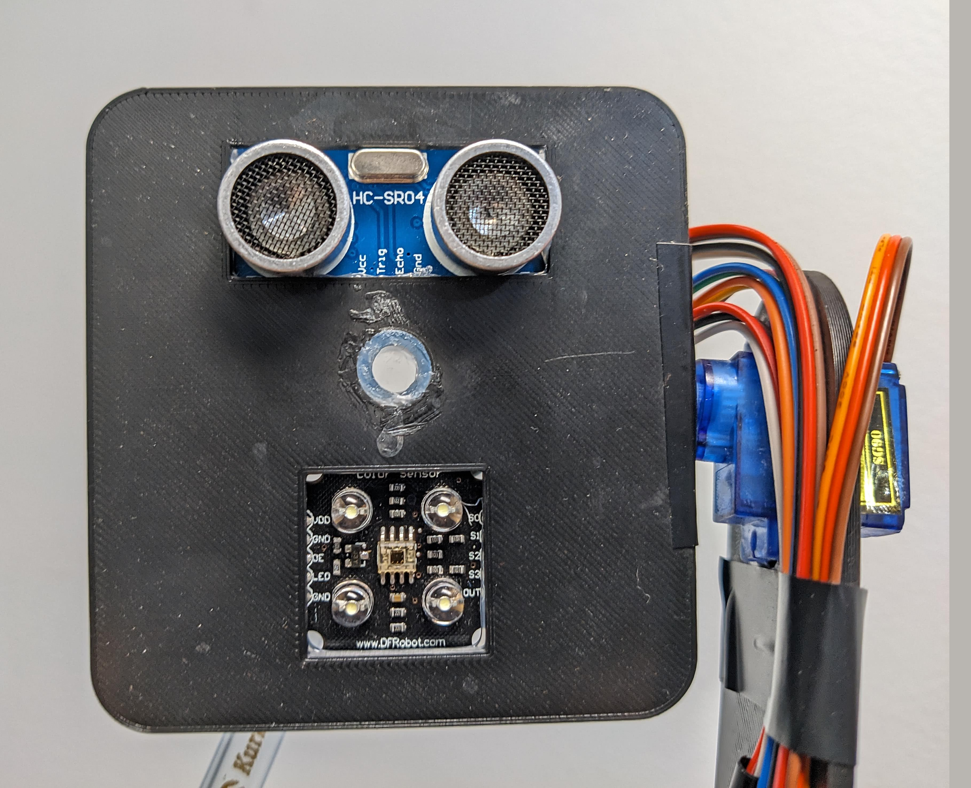
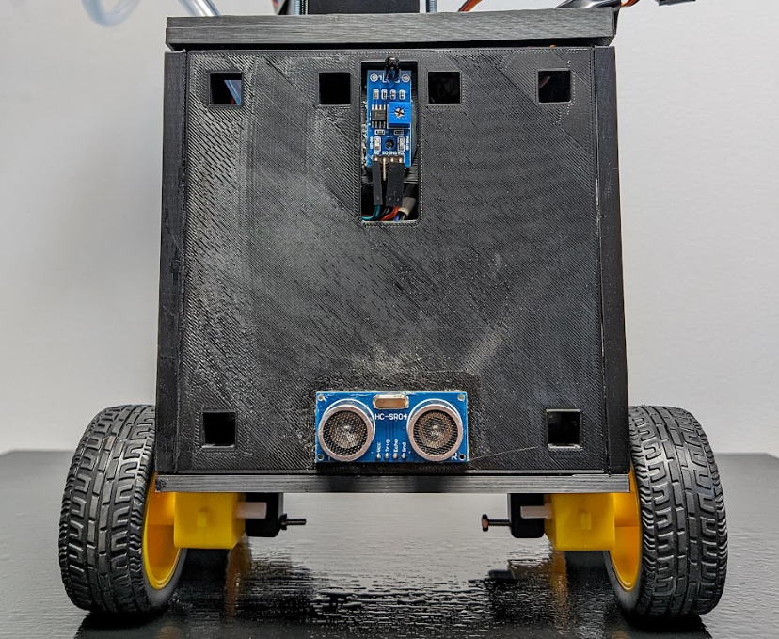
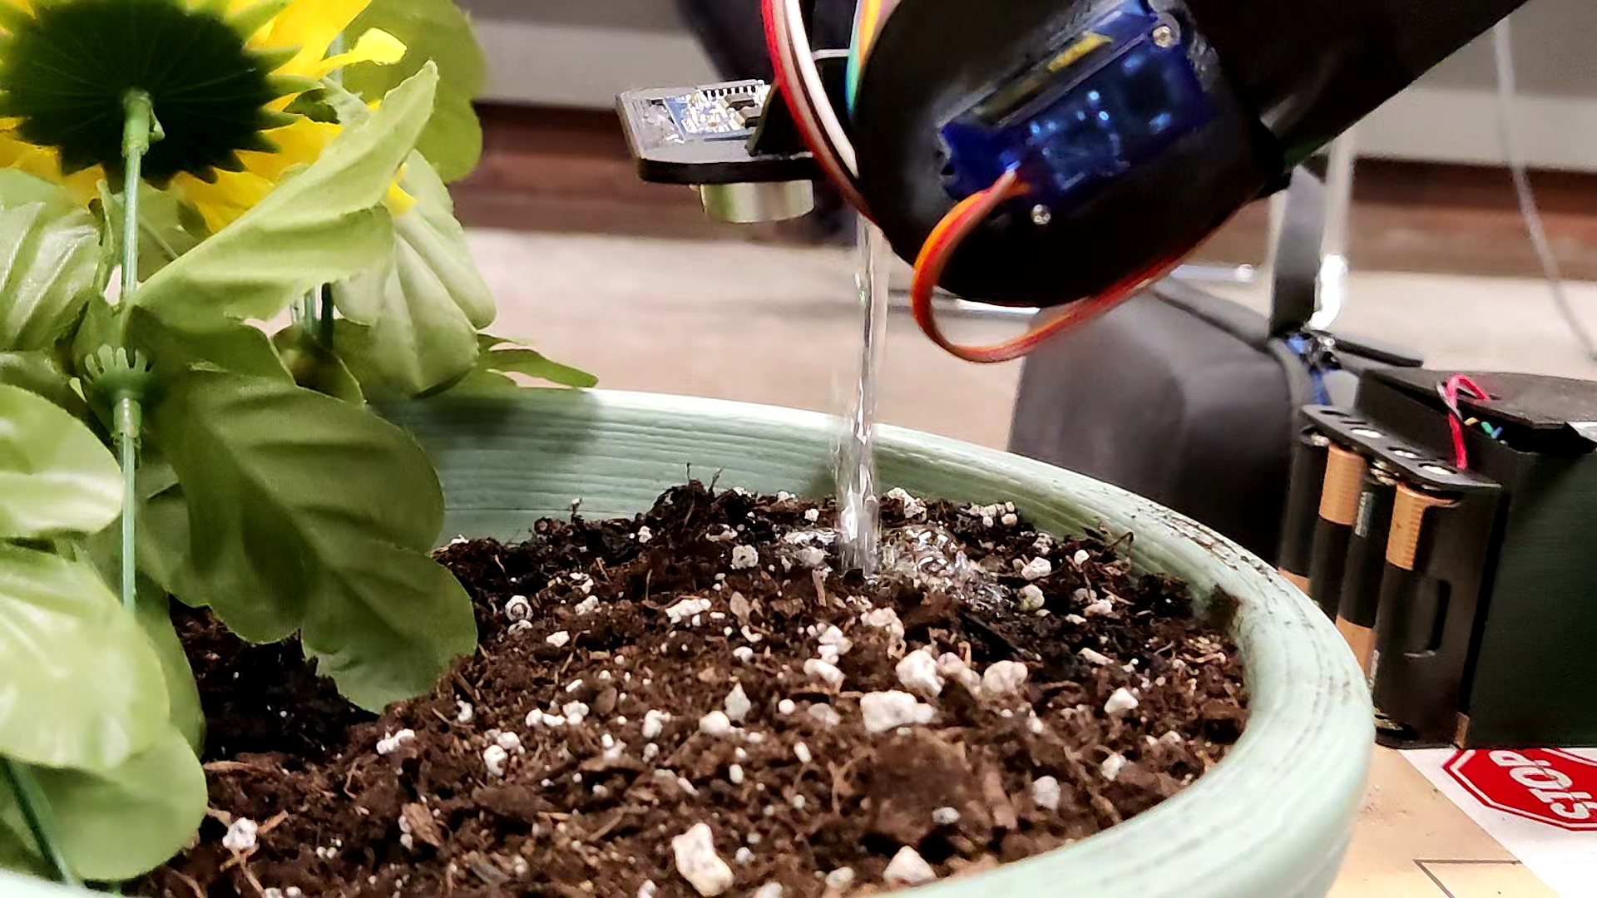
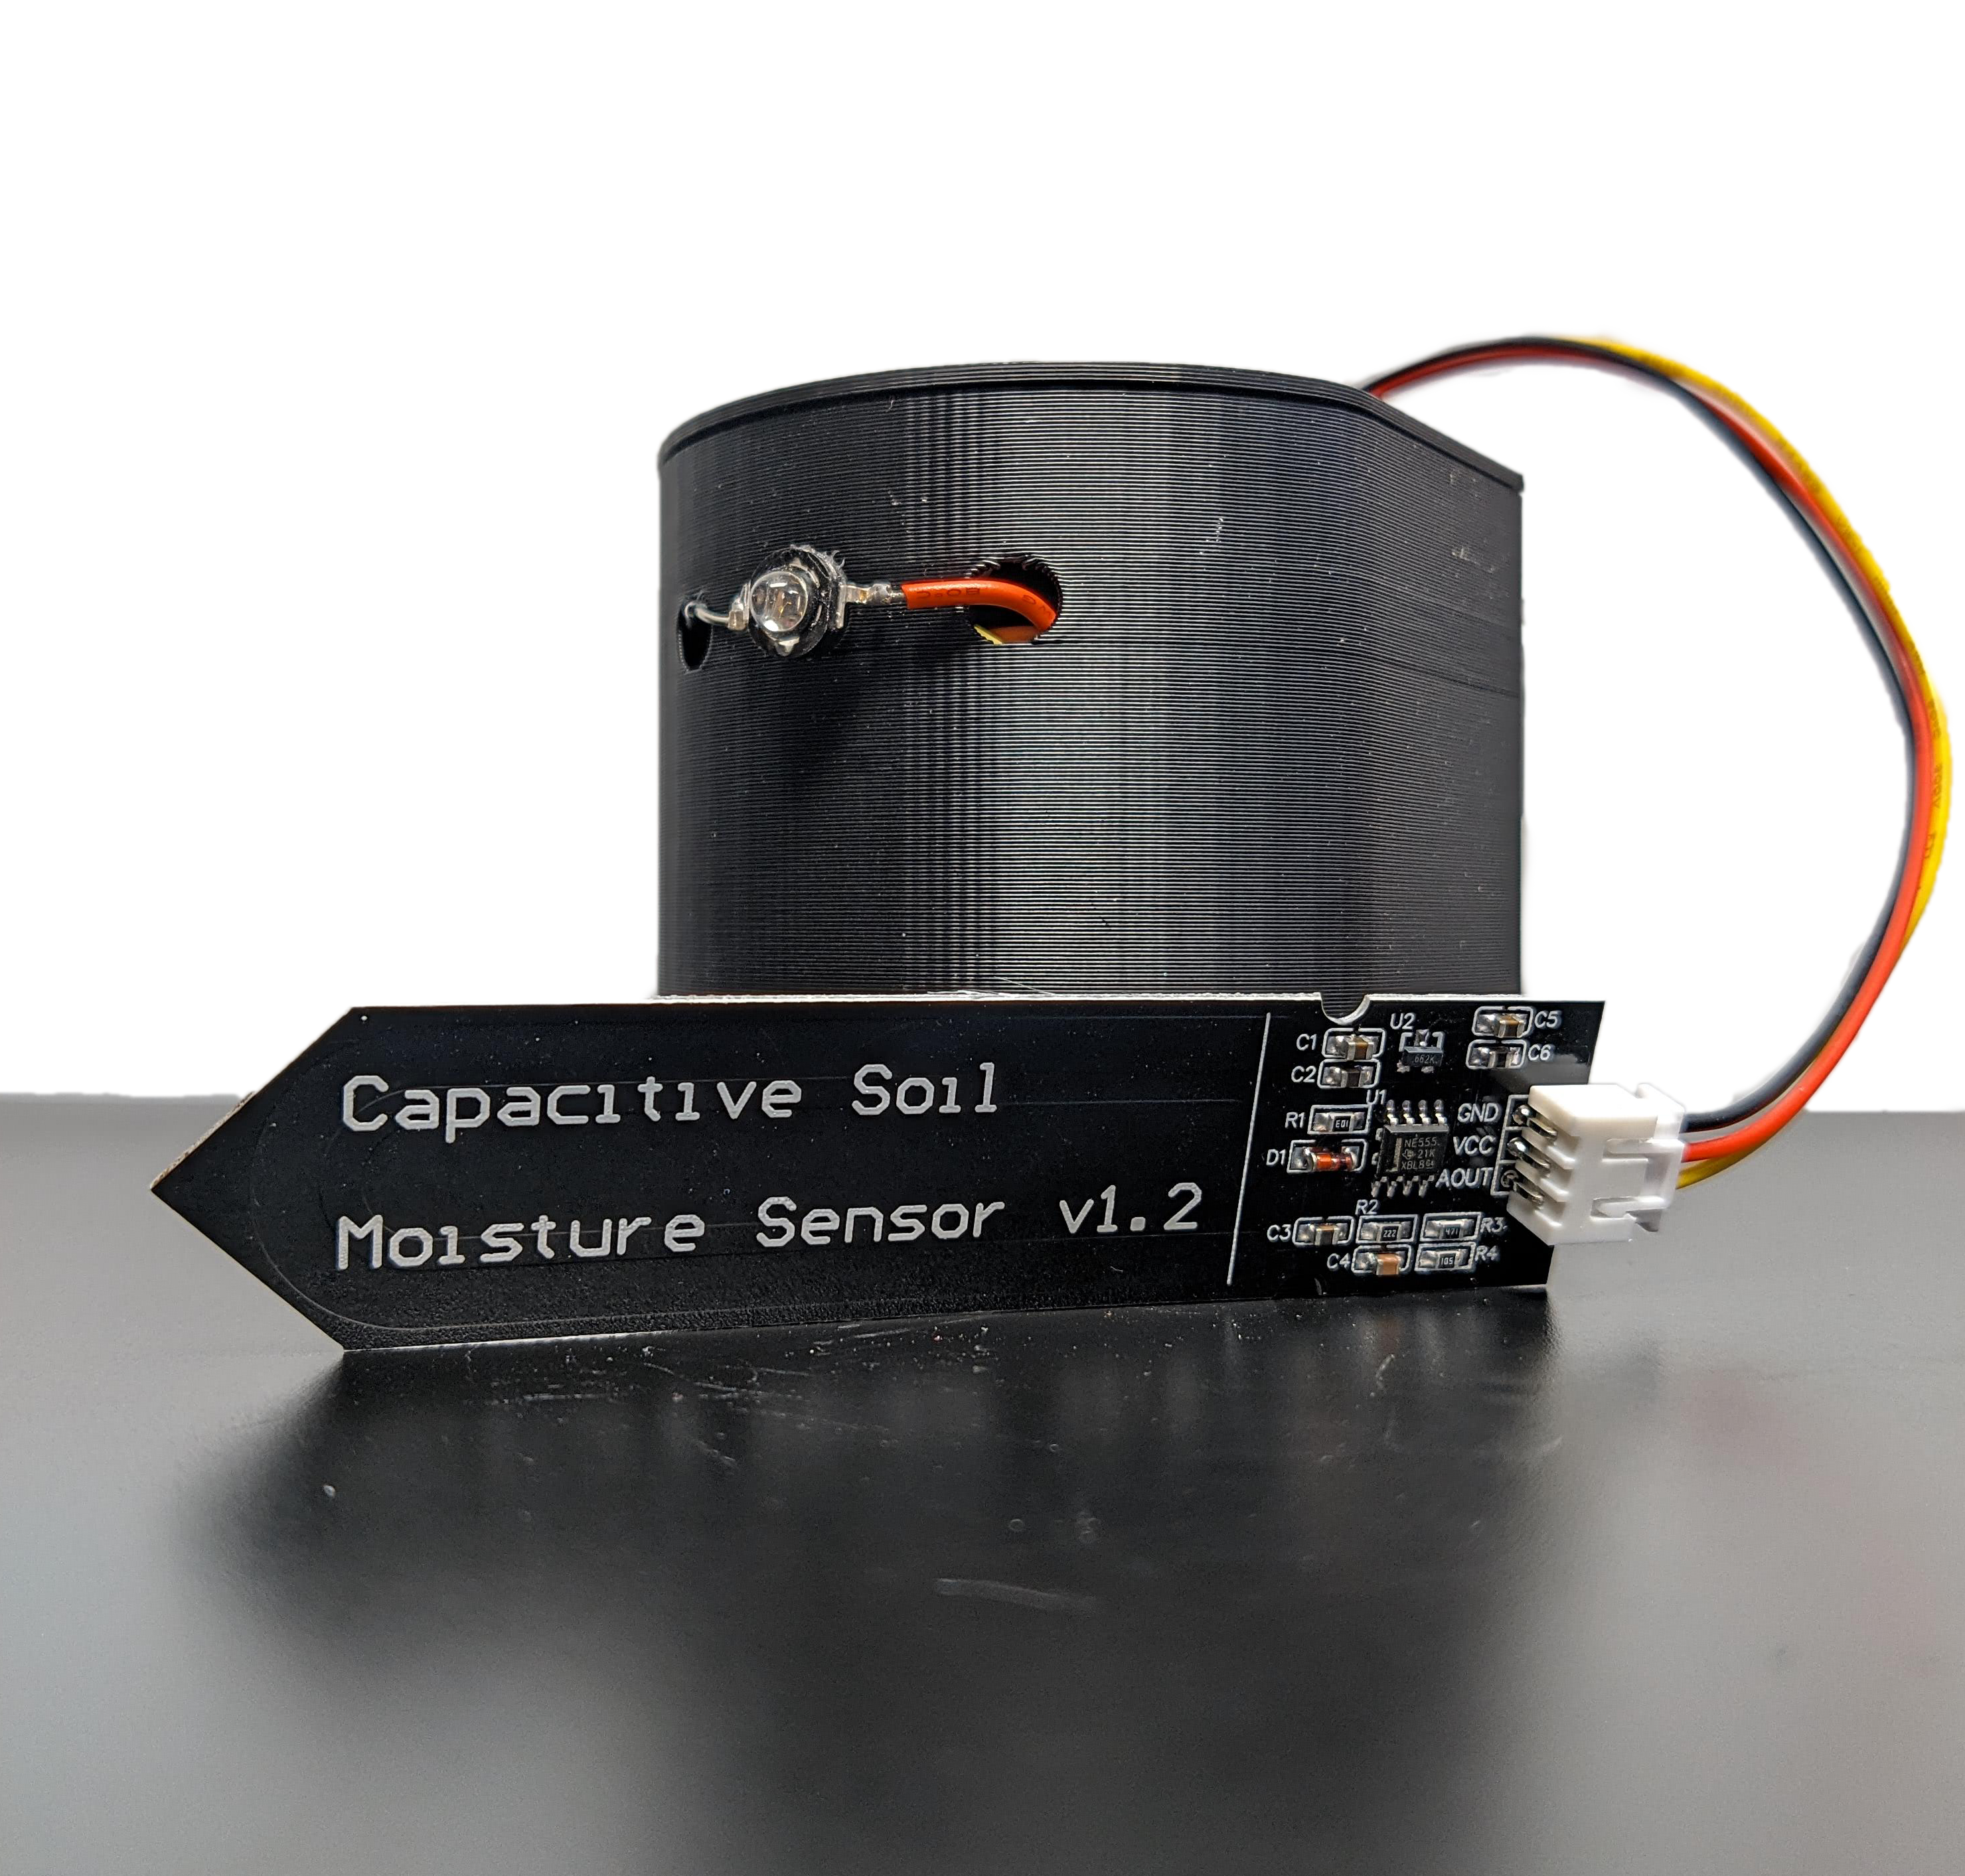
SPROUTBOT​
Mechatronics Capstone
Project
BOTANICA
Arun Mistry
Mina Demian
Nicholas Levantis
Usman Minhas
Product
Description
Features
SproutBot is a completely autonomous solution to watering your plants!
This Indoor Plant Watering Robot is perfect for busy plant owners to water plants regularly!
Movement: 4 Motors + Ultrasonic Sensor
Navigation: Autonomous Navigation with IR + 6m Range
Monitoring: Real Time Notification through website
Water Delivery: 3 DOF Arm + 850ml Water Tank (7 days)
WATERING ARM
ROBOT
ACCURATELY DETECTS SOIL
LOCATES PLANTS
UP TO 6m AWAY (IR)
AVOIDS OBSTACLES
WATER TANK
NON-SLIP TYRES
Plant Attachment
Operation Procedure
Market Analysis
IR LED
In 2020, the COVID-19 pandemic led to 20 million new US gardeners.
The Global Garden Robot Market is projected to reach $7 billion USD by 2033.
This is an untapped market, as no Mobile Indoor Plant Watering Robots exist.
MOISTURE SENSOR

